Slide 1
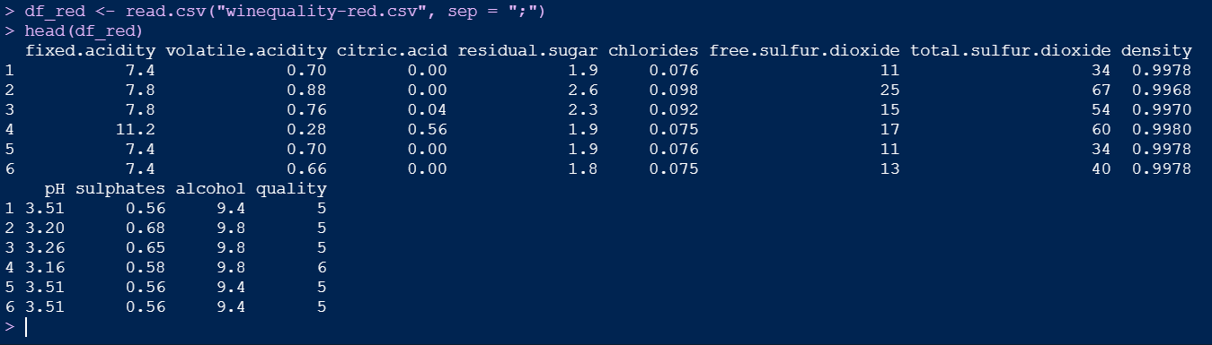
Regression
Exercise - Wine Quality Data Set
https://archive.ics.uci.edu/ml/datasets/wine+quality
Load the dataset

Slide 2
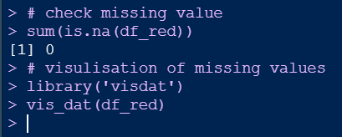
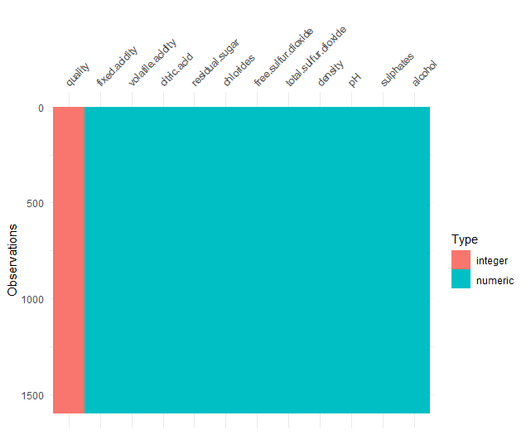
Regression
Exercise - Wine Quality Data Set
Check the missing value

Slide 3
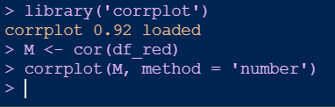
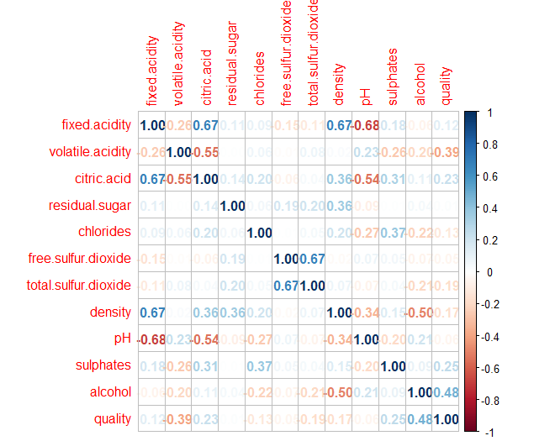
Regression
Exercise - Wine Quality Data Set
Correlation analysis

Slide 4
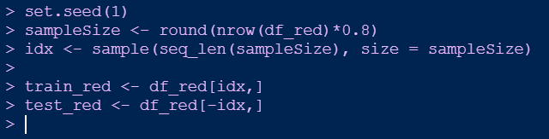
Regression
Exercise - Wine Quality Data Set
Modelling
Splitting Train Datasets and Test Datasets

Slide 5
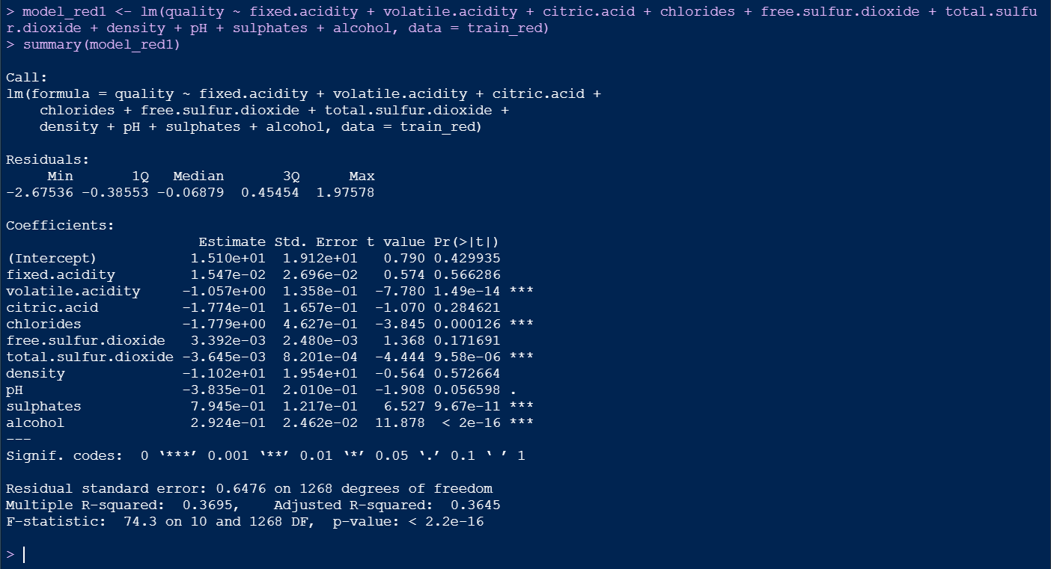
Regression
Regression Tutorial - Wine Quality Data Set
Modelling
Create linear regression model using all the features

Slide 6
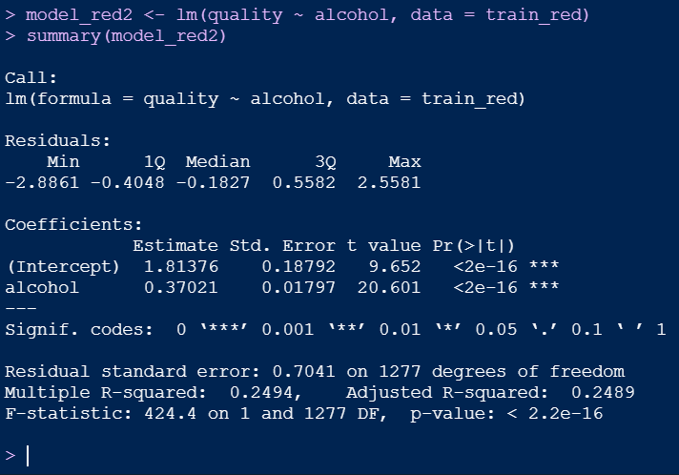
Regression
Exercise - Wine Quality Data Set
Modelling
Create linear regression model using only one feature

Slide 7
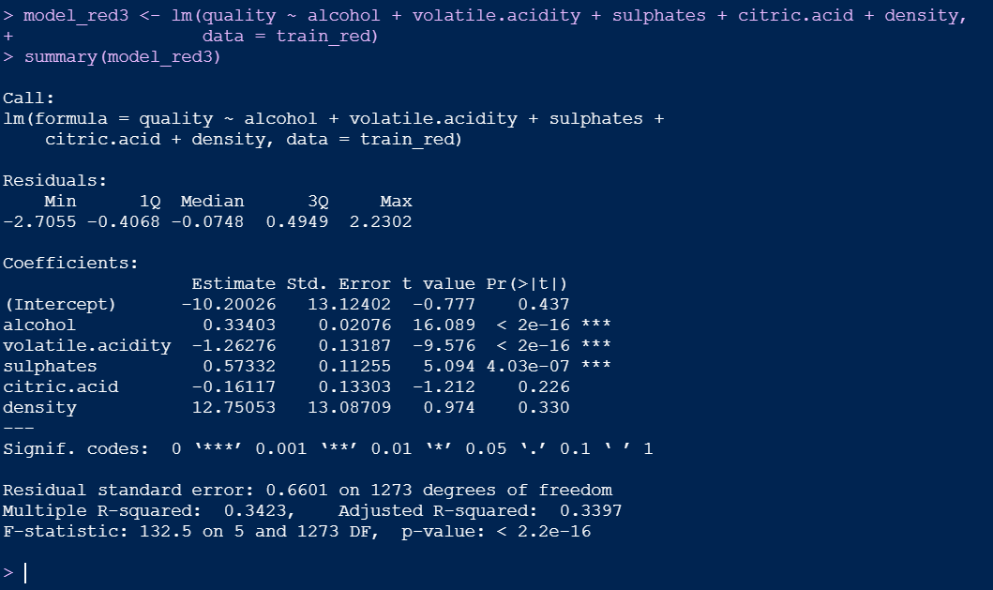
Regression
Exercise - Wine Quality Data Set
Modelling
Create linear regression model using top 5 most correlated features

Slide 8
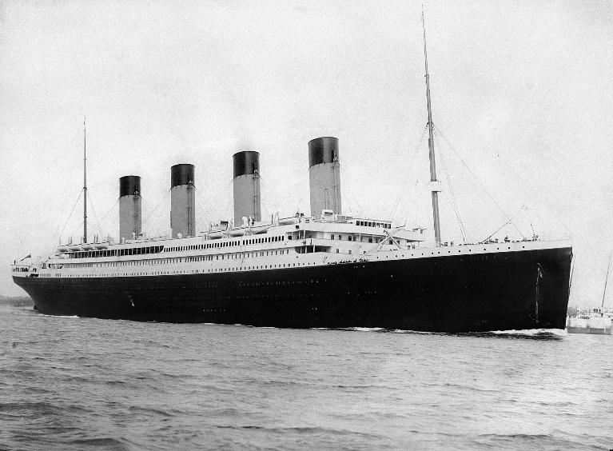
Logistic Regression
Exercise
Studying the Titanic passenger survival
Titanic dataset from Kaggle https://www.kaggle.com/c/titanic
build a logistic regression model for survival
RMS Titanic, By F.G.O. Stuart (1843–1923)

Slide 9
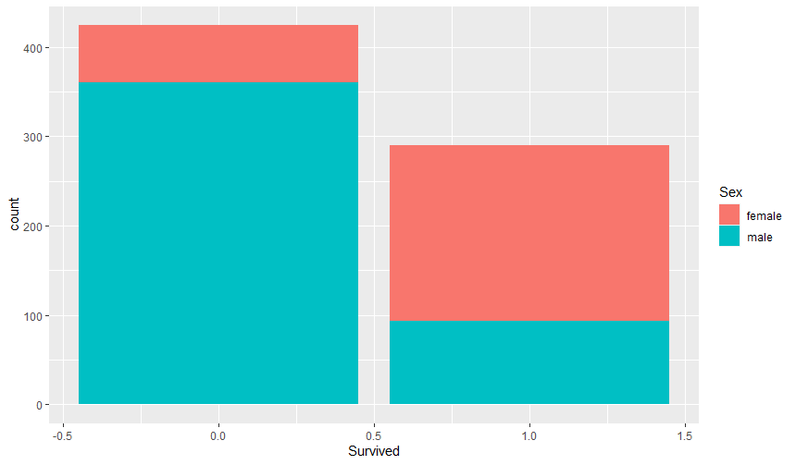
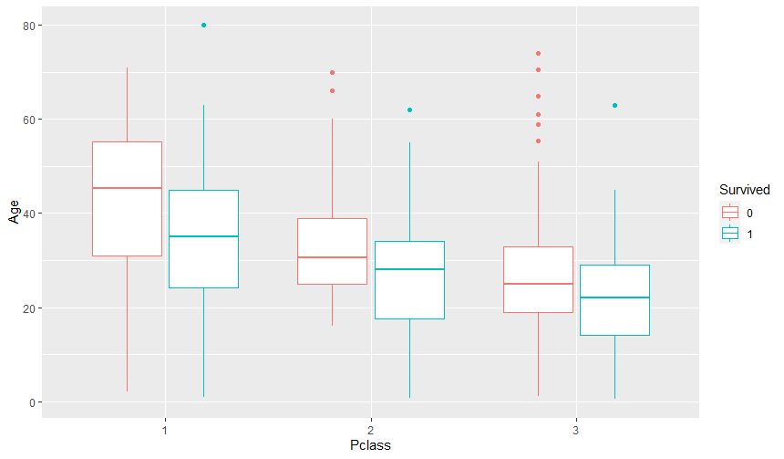
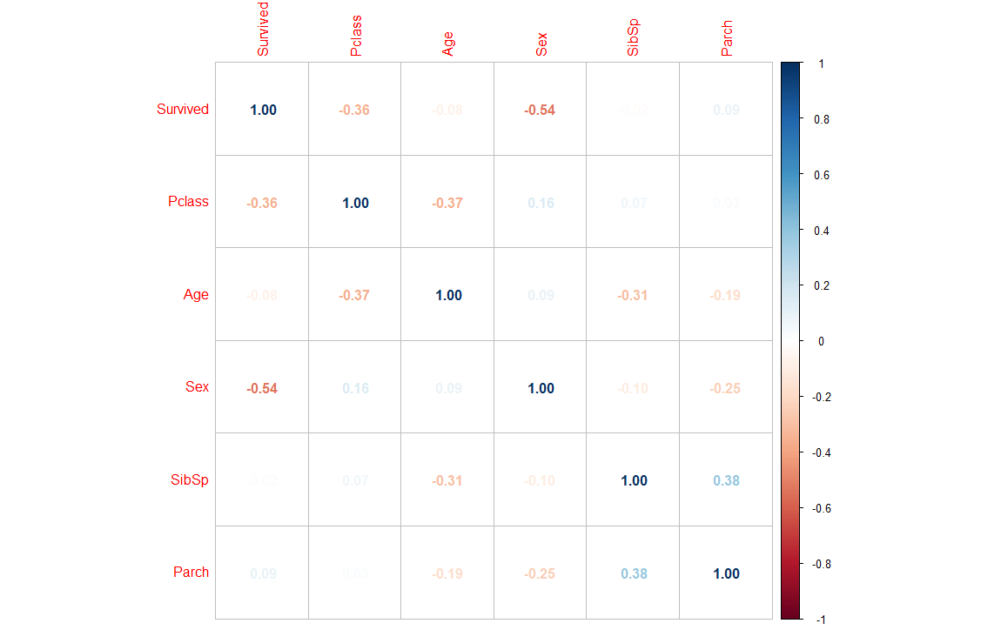
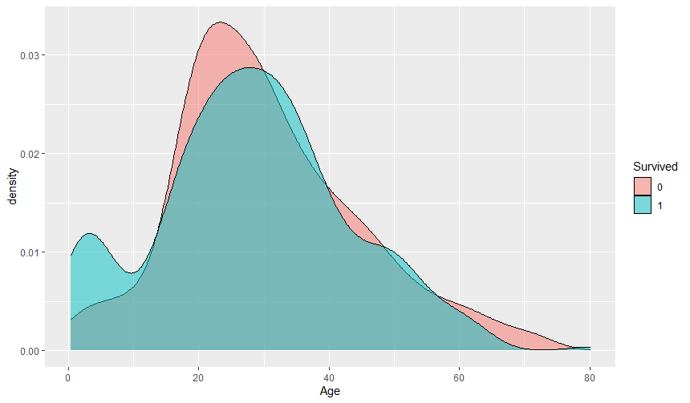
Logistic Regression
Exercise
Review data exploratory analysis in Week 3

Slide 10
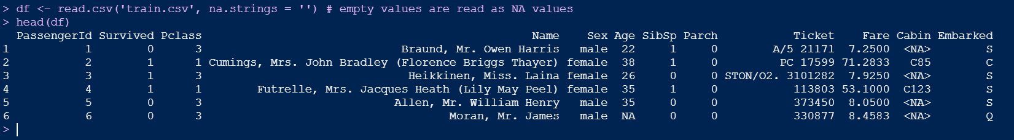
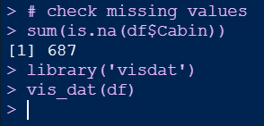
Logistic Regression
Exercise
Load the data
Check missing values

Slide 11
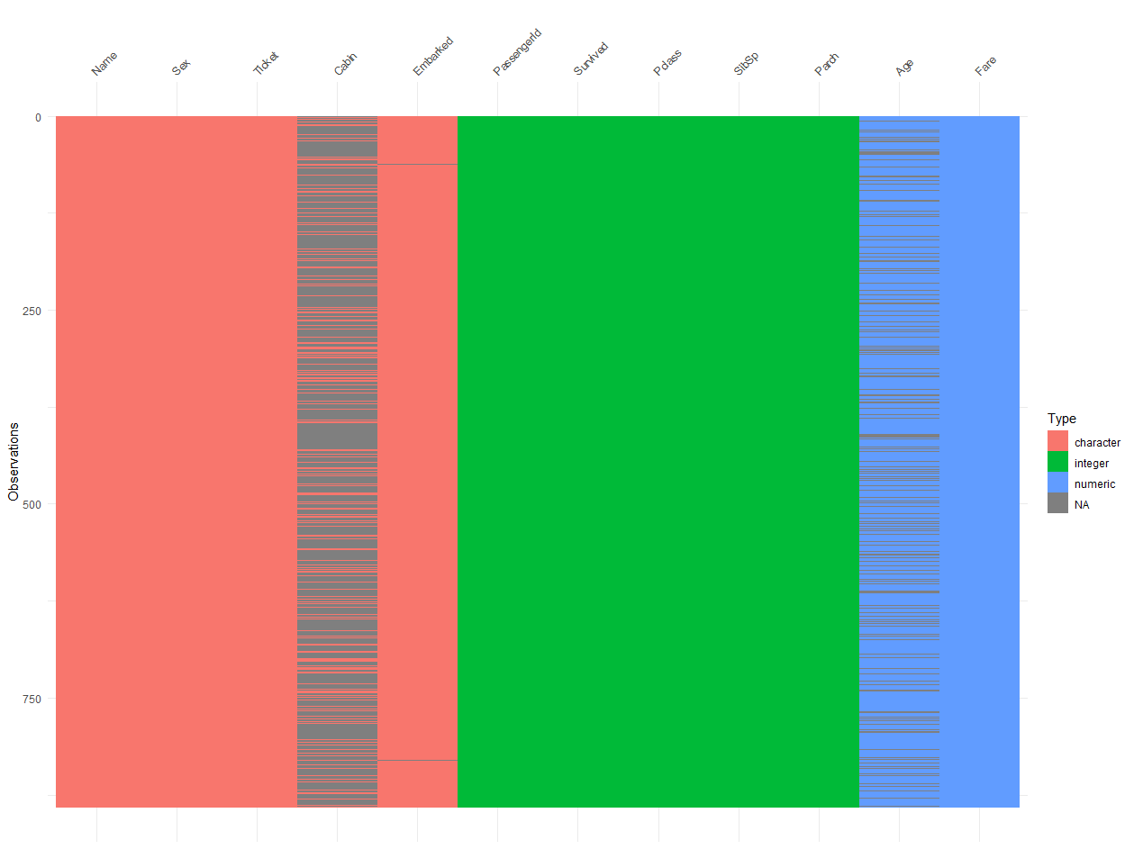
Logistic Regression
Exercise
Missing values

Slide 12
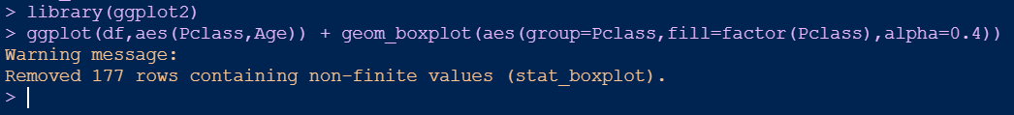
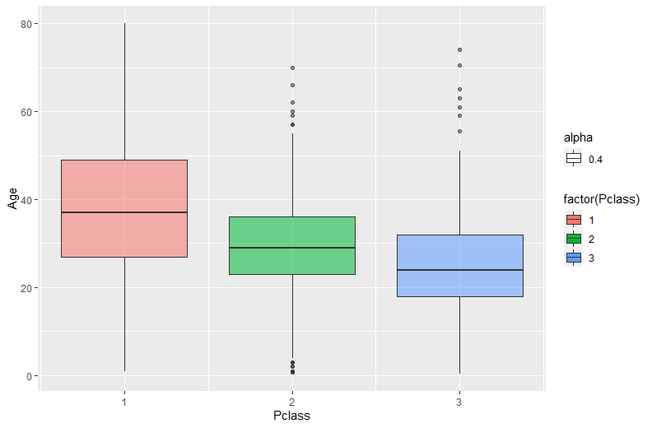
Logistic Regression
Exercise
Age vs Pclass

Slide 13
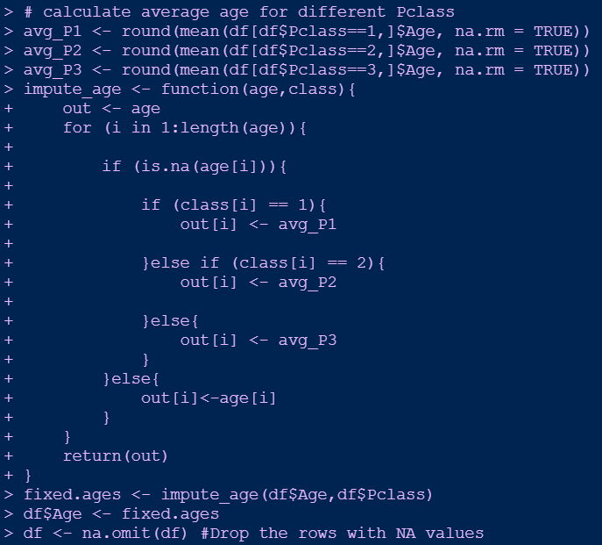
Logistic Regression
Exercise
Impute missing age values

Slide 14

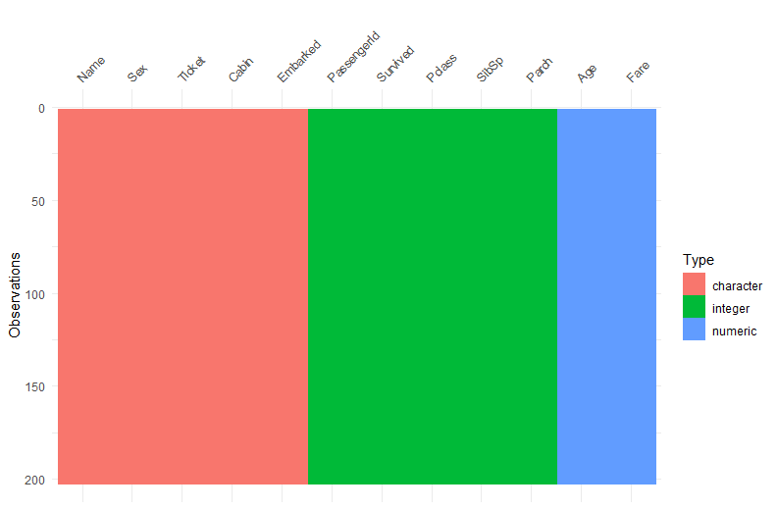
Logistic Regression
Exercise

Slide 15
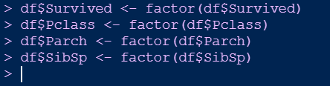
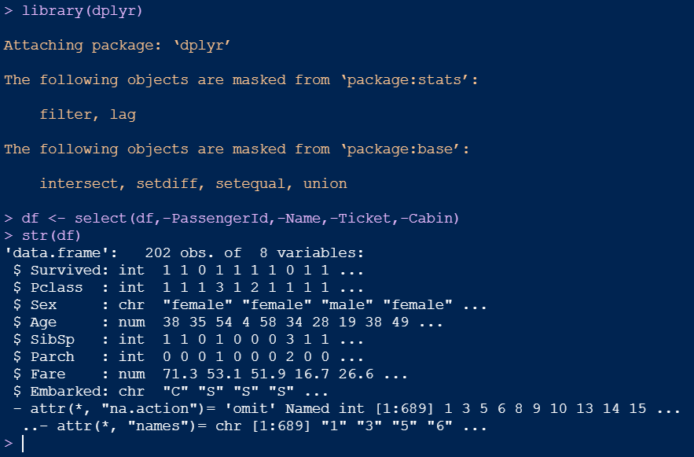
Logistic Regression
Exercise
Select features

Slide 16
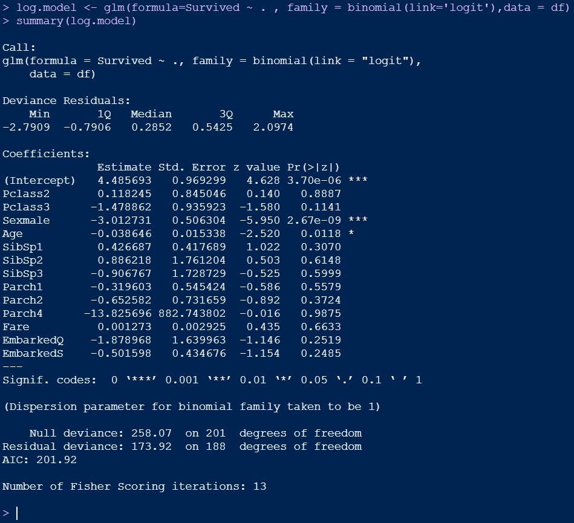
Logistic Regression
Exercise
Build logistic regression model to predict survival
We can see clearly that Sex, Age are the most significant features. Which makes sense given the women and children first policy.

Slide 17
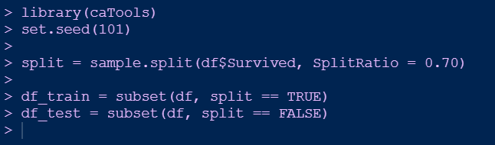
Logistic Regression
Exercise
Predicting using Test cases
Training and test split
https://stackoverflow.com/questions/17200114/how-to-split-data-into-training-testing-sets-using-sample-function

Slide 18
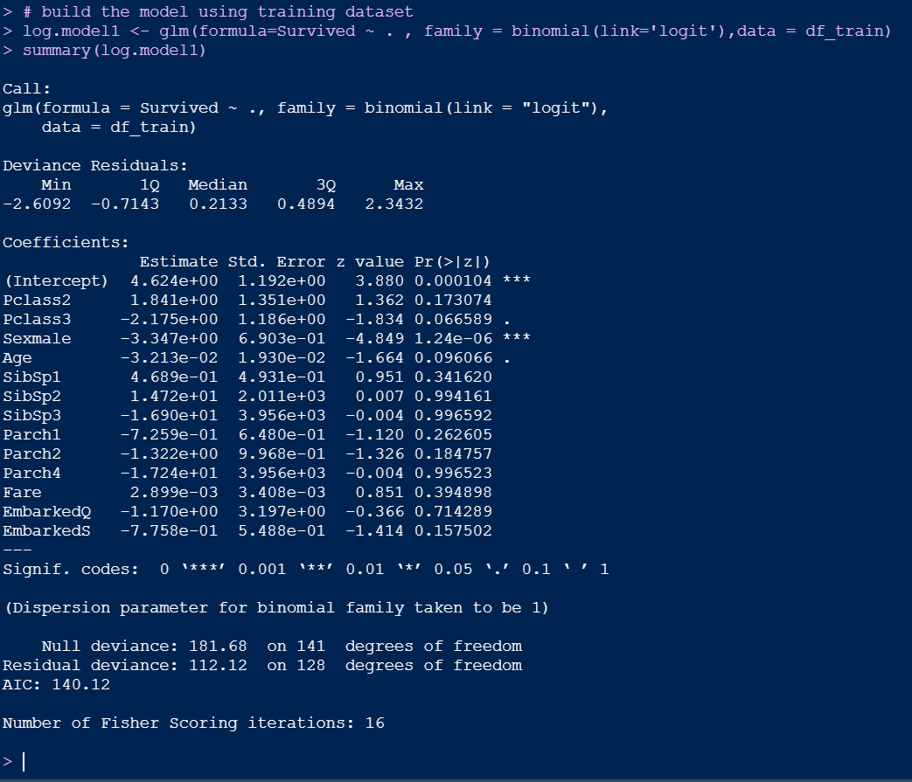
Logistic Regression
Exercise
Build the model using training dataset

Slide 19
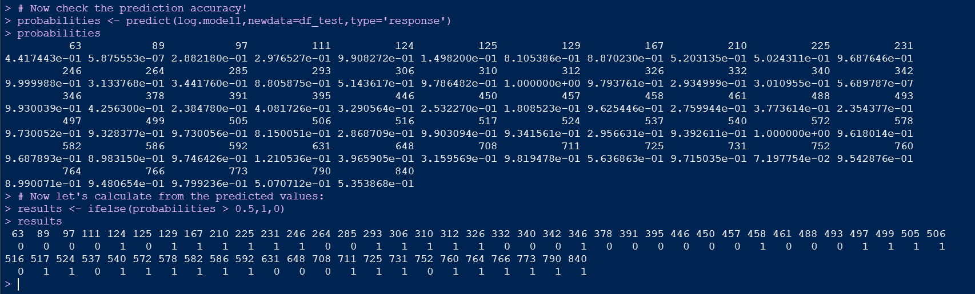
Logistic Regression
Exercise
Check the prediction accuracy

Slide 20
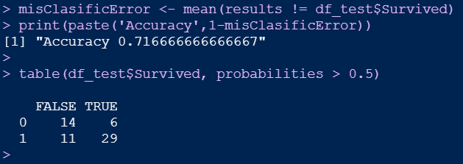
Logistic Regression
Exercise
Check the prediction accuracy

Slide 21
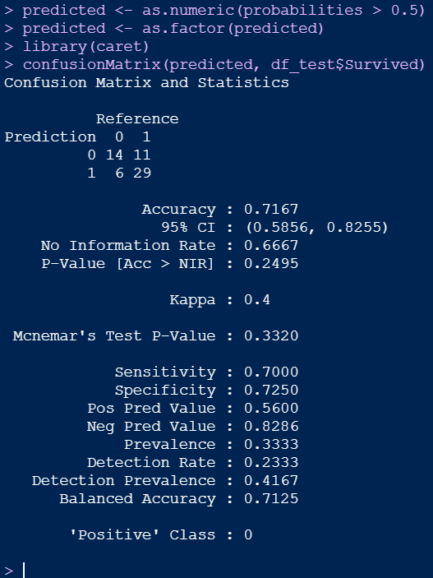
Logistic Regression
Exercise
Confusion matrix

